Slide 1

Decision Tree

Slide 2
What is decision tree
it uses a tree-like model of decisions.
it has influenced a wide area of machine learning, covering both classification and regression.
internal node denotes a test on an attribute.
branch represents an outcome of the test.
each leaf node (terminal node) holds a class label.

Slide 3
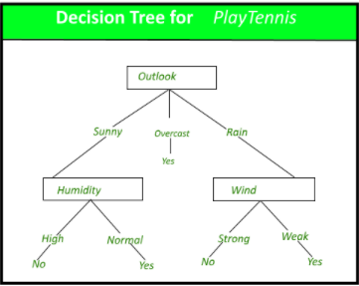

Slide 4
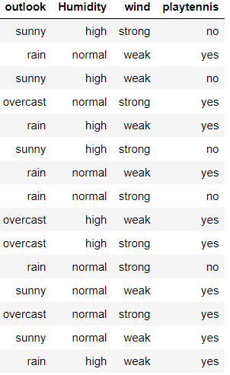
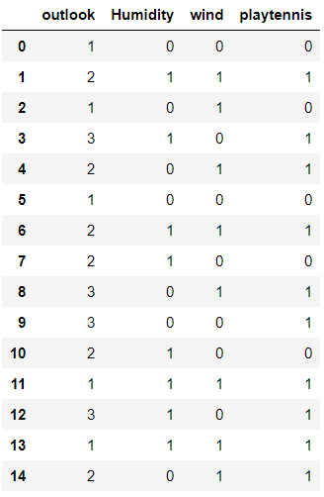
Outlook sunny overcast rain humidity wind high normal strong weak no yes yes no yes

